Slide 1
DROID-SLAM in the Wild
Problem addressed: Traditional RGB SLAM assumes a mostly static environment, so moving objects can cause camera-tracking failures and inaccurate 3D reconstruction, especially in crowded and cluttered scenes.
Proposed solution: DROID-W estimates per-pixel uncertainty using multi-view visual feature inconsistency and incorporates it into differentiable, uncertainty-aware Bundle Adjustment.
Key benefit: Reduces the influence of unreliable visual observations without relying entirely on predefined dynamic-object categories, enabling more robust camera-pose estimation and 3D mapping at approximately 10 FPS.

Slide 2
Problem: Traditional SLAM assumes static scenes, so dynamic and non-rigid objects cause camera-pose errors and inaccurate 3D reconstruction.
Limitation of existing methods: Motion detection and segmentation methods depend on predefined dynamic-object knowledge, while existing uncertainty-aware methods often require a reliable static 3D map to estimate pixel-wise uncertainty.
Proposed solution — DROID-W: Extends DROID-SLAM to dynamic environments by integrating uncertainty optimization into differentiable Bundle Adjustment (BA), jointly updating pixel-wise uncertainty, camera poses, and scene geometry using multi-view visual feature similarity.
Key advantage: Estimates uncertainty without relying on predefined motion priors or high-quality geometric maps, improving robustness in complex, cluttered, real-world scenes.
Additional contribution: Introduces the DROID-W dataset with diverse outdoor dynamic scenes and YouTube videos for in-the-wild evaluation.
Result: Achieves state-of-the-art camera tracking and 3D geometry reconstruction in the evaluated scenarios at approximately 10 FPS.

Slide 3
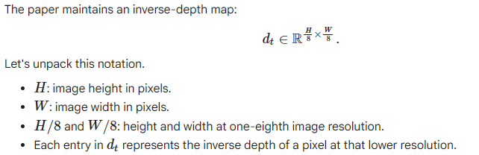

Slide 4
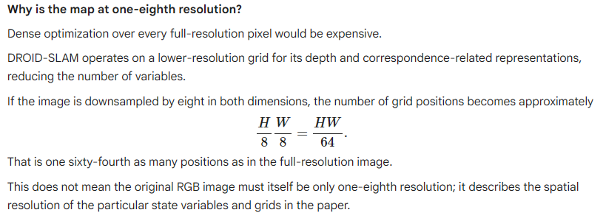

Slide 5
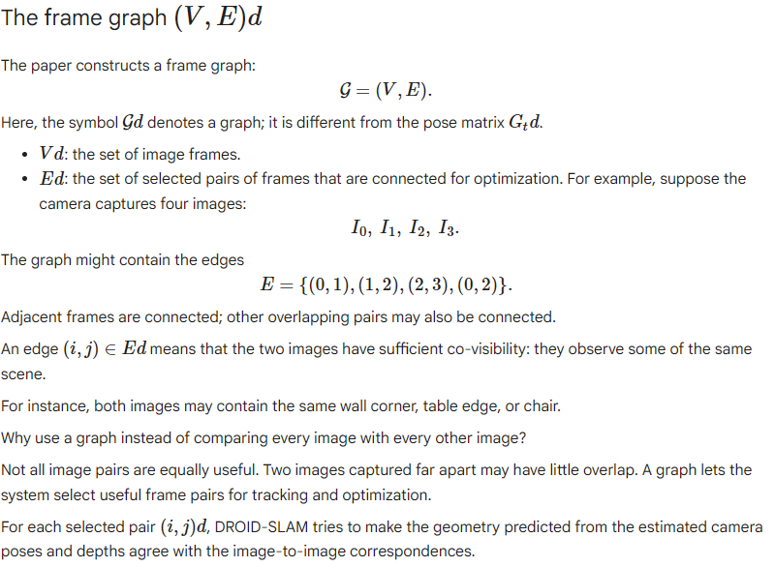

Slide 6
Differential bundle adjustment (BA)
Bundle adjustment is an optimization process that jointly refines:
    Camera poses.
    Scene geometry, represented here by inverse depths.
The word differentiable means that the geometric operations can be differentiated with respect to the quantities being optimized.
Their derivatives tell the optimizer how changing a pose or depth would change the predicted pixel locations.
DROID-SLAM uses a differentiable BA layer so that the geometric optimization can also participate in learning the neural network.

Slide 7
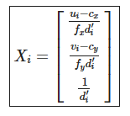
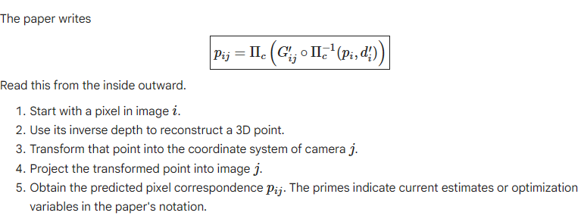
Predicting where a pixel should appear in another image

Slide 8
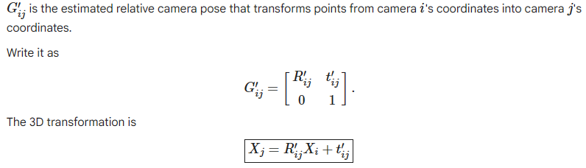
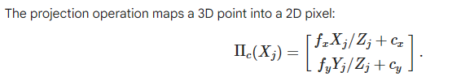


Slide 9



computed from the current pose and inverse-depth estimates.
For each grid position in image (i), the network estimates the corresponding location in image (j)

Slide 10
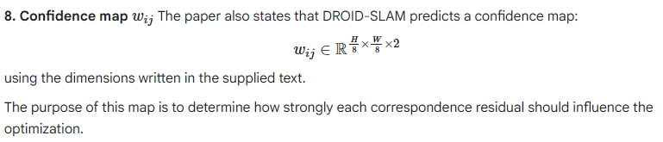
Not every correspondence is equally reliable. A featureless wall, an occluded region, a moving person, or a repetitive texture may produce an uncertain correspondence.
If every pixel were trusted equally, incorrect correspondences could distort the estimated camera motion and scene depth.
What does the confidence do?
High confidence means the correspondence is trusted more.
Low confidence means the correspondence is trusted less. The exact interpretation of in the objective is important: it is used as a weight or, equivalently under the usual Gaussian-error interpretation, as an inverse-uncertainty quantity.

Slide 11
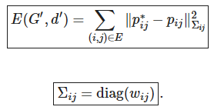
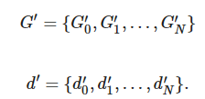


The bundle-adjustment objective The paper writes the energy as
What are G′ and d′ ? These represent the collection of pose and inverse-depth estimates being optimized.

Slide 12
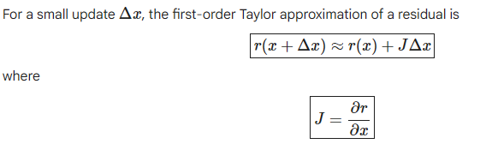
DROID-SLAM uses the Gauss–Newton algorithm to obtain an iterative solution.
The fundamental idea is:
Start with the current pose and depth estimates.
Calculate the current residuals.
Approximate how the residuals change for small parameter updates.
Solve a linear system for those updates.
Apply the updates.
Recompute the residuals and repeat.

Slide 13
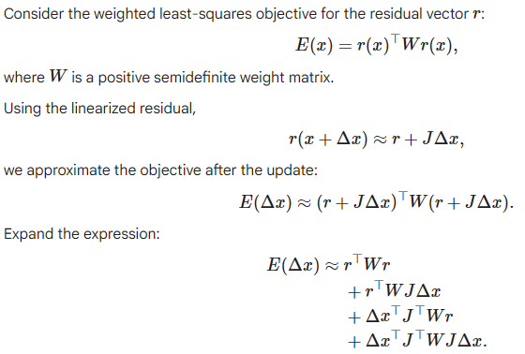

Slide 14
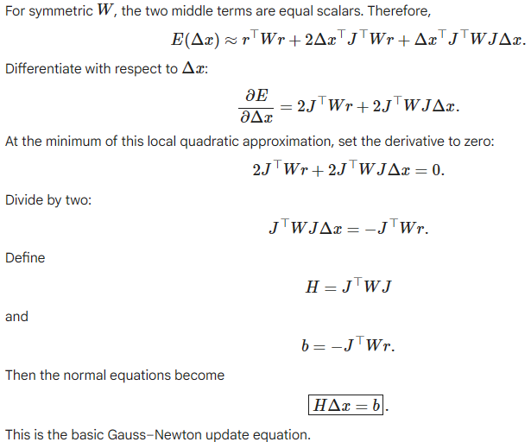

Slide 15
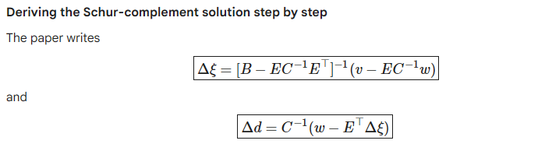

Slide 16

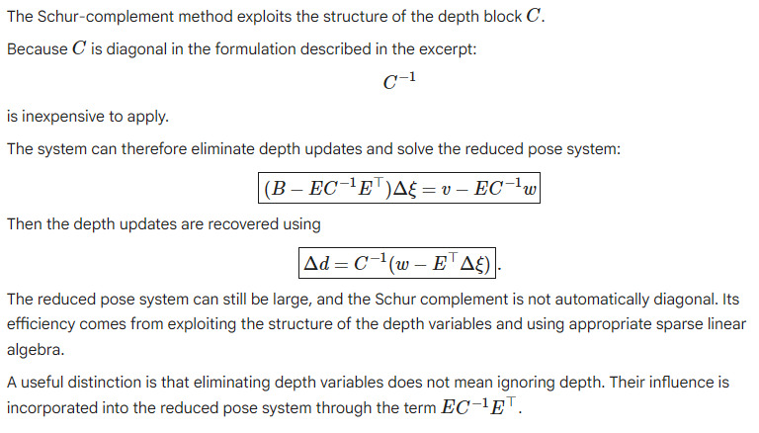

Slide 17
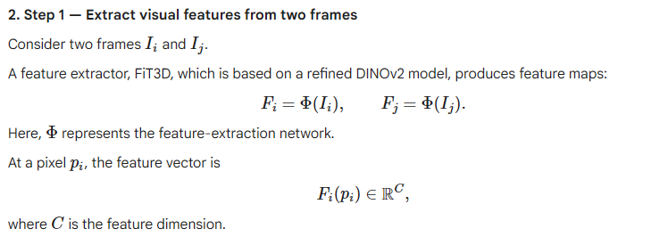
Uncertainty Optimization:
The optimization has three main ingredients:
A feature-similarity loss that encourages inconsistent correspondences to receive high uncertainty.
A logarithmic prior that prevents uncertainty from growing without bound.
A learned mapping from DINOv2 features to uncertainty, which regularizes the uncertainty spatially.

Slide 18
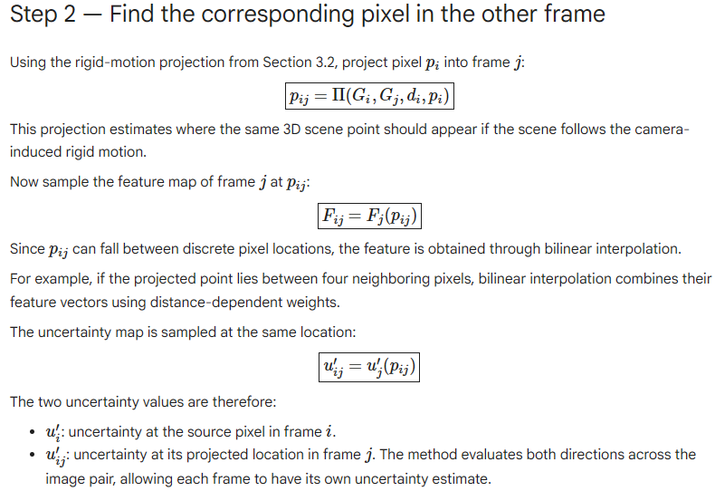

Slide 19
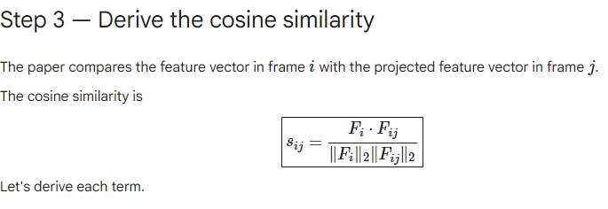

Slide 20
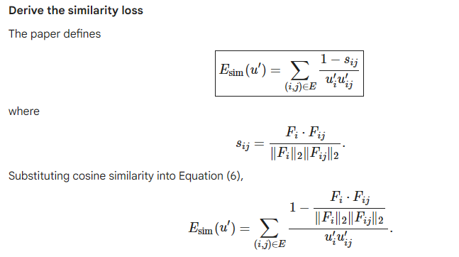

Slide 21
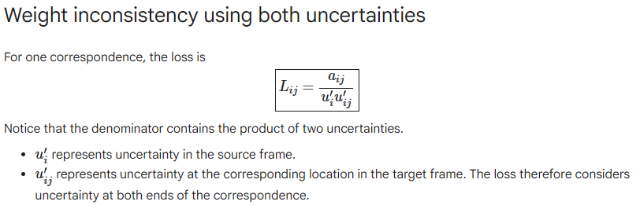

Slide 22
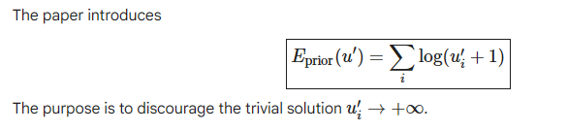
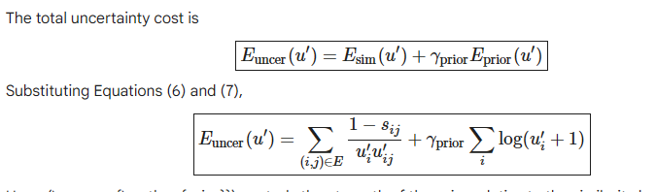

Slide 23
Uncertainty regularization — Why learn uncertainty from DINOv2 features?
So far, uncertainty has been treated as an independent variable for every pixel.
Suppose an image contains uncertainty values.
Directly optimizing all of them independently can produce a noisy uncertainty map: neighboring pixels might receive very different uncertainty values even when they belong to the same object.
This is called spatial inconsistency or overfitting to local noise.

Slide 24
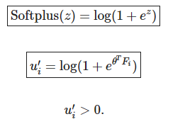
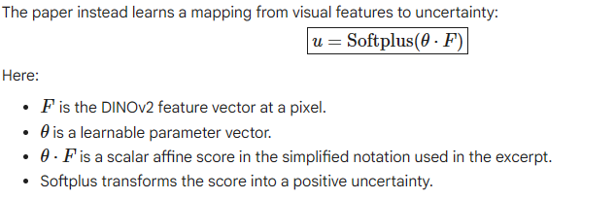

Slide 25
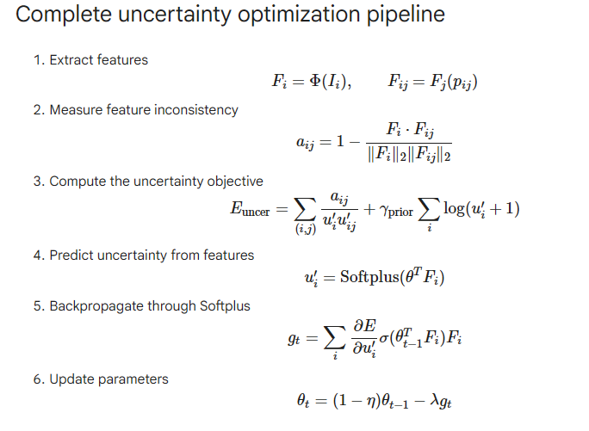

Slide 26
Ablation Studies
Dynamic objects: Moving objects introduce unreliable reprojection errors and degrade camera pose estimation.
Visually complex scenes: Motion blur, overexposure, clutter, and highly textured backgrounds can degrade mapping and uncertainty estimation.
Initialization: Uncertainty estimation can be inaccurate when initial camera poses are unreliable.
Runtime: The method is slightly slower than DROID-SLAM because of monocular depth estimation and DINOv2 feature extraction.
Limitations of other methods: WildGS-SLAM can produce incorrect uncertainty estimates and reconstruction failures; feed-forward methods such as MonST3R and TTT3R show higher tracking errors in the reported experiments.

